Slide 1
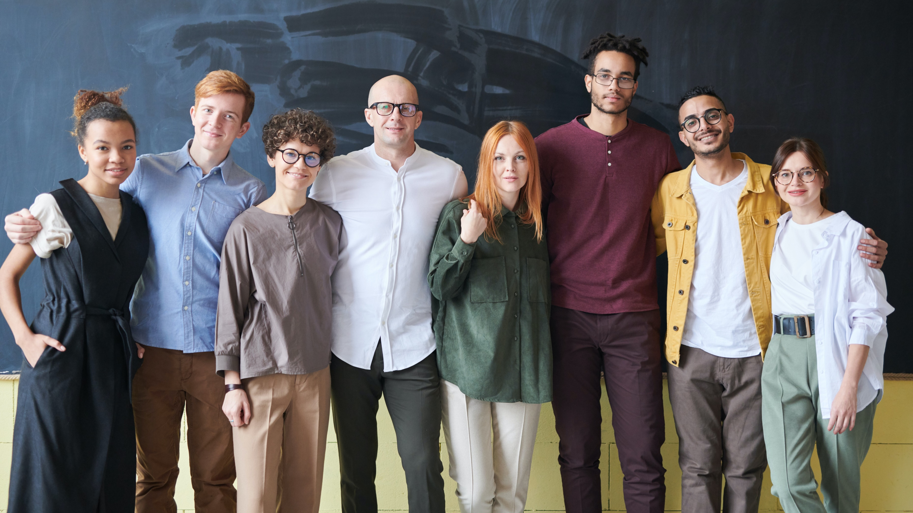
WE ARE INDEPENDENT PROFESSIONALS

Slide 2
INDEPENDENT PROFESSIONALS
(aka freelancers)
Creating value in growing numbers
Expected to perform more, better
BUT
Excluded from corporate support
Less development opportunities
Difficult to network

Slide 3
You find this acceptable ?
… Neither do we, that’s why there’s
Digital Ecosystem by and for INDEPENDENT
PROFESSIONALS

Slide 4
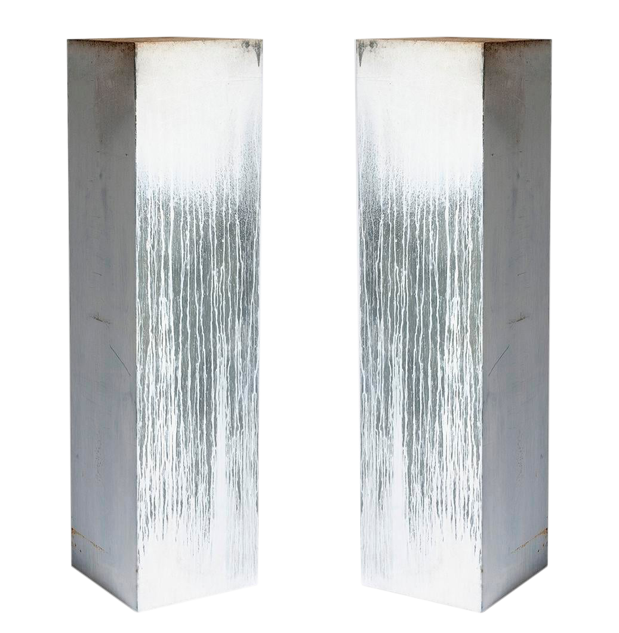
THREE PILLARS IN SERVICES
Peer to Peer Development
Peer to Peer Caring
Peer to Peer Business

Slide 5
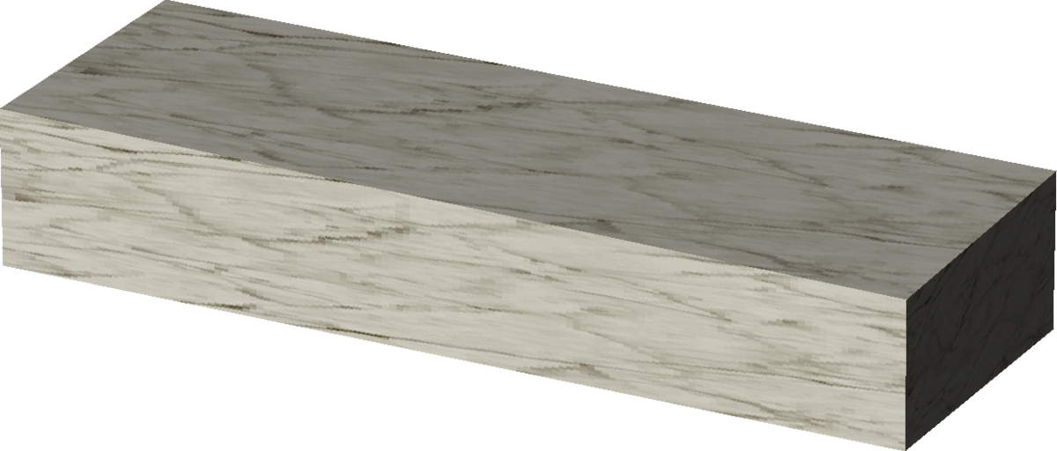
VALUE FOUNDATIONS
Care > Empathy > Trust
Grow > Share > Impact
Create Sustainable Value

Slide 6
FINANCIAL COVER
Membership fee sharing
Event booking fees
Job finder fees

Slide 7
GOLD (48€ / month)
one month free trial
MAKE BETOOBE
YOUR HOME
Designed for Independent professionals who want to experience the full power of a peer expert network to grow and develop their business.
◆ Access to content  Receive advice from experts  Book training  Participate in peer to peer webinars  Company profiles  Business opportunities  Team discussions  Member Advantages  Join communities of practice  Online collaboration

Slide 8
PLATINUM (96€ / month)
one month free trial
MAKE BETOOBE
YOUR OTHER BUSINESS
Designed for Independent professionals who want to use an expert peer network to grow their business and generate extra income by contributing to the success of their peers.
Income generating activities:  delivering webinars for a fee  inviting new members and caring for them  identifying business opportunities for members  organizing live events  animating communities
4 active referrals or 1 hour webinar per month and you get your monthly fee back ! … but there’s more …

Slide 9
Sample scenarios of income amounts generated by business opportunities available on betoobe.
Lina invites 5 members and supports them to do the same with paid events
Marc finds a 3 month contract for one other member each month
Ellen manages a community of 500 members, built through (in)direct referrals
Kevin organises weekly webinars for 10 groups of 10 participants
Monika builds, manages and animates several communities reaching 3000 members in total
600€ / month
1.800€ / month
5.400€ / month
9.000€ / month
20.000€ / month

Slide 10
Join one of our free webinars
or visit us online
betoo.be

