Slide 1


growth, recognition and satisfaction for Independent Professionals

Slide 2
betoobe fulfils Independent Professionals* aspirations for growth, recognition and satisfaction through an organised ecosystem enabling them to make a difference ... together!
* Independent Professionals are independent workers without employees
engaging in intellectual service activities to businesses.

Slide 3

growth & recognition

Slide 4


You need a quick support session on a very specific topic ? You’re seeking hands-on experience sharing from an expert ? You’re looking for highly efficient yet cost-effective mentoring sessions ? You prefer live sessions and yet you hate commuting ?
betoobe provides all you need to request and book on demand live Mindshare sessions in a professional online platform – from professionally trained instructors.
If it is not yet made available by one of your fellow members, just ask for it.
Unique ecosystem to request and receive field experience sharing from fellow Independent Professionals

Slide 5

Unique ecosystem to request and receive expert advice from fellow Independent Professionals
Ask the expert ! You will get accounting advice from an accountant, marketing advice from a marketeer, IT advice from an IT specialist through our unique expert clinic program.
Ask the expert ! You will have access to inside knowledge of a potential client.
Ask the expert ! You will be fed about news in your field or about general business management.
Ask the expert ! You will get a lot of attention for career or business ideas you would like to test.

Slide 6

Any member who can demonstrate expertise and training skills can organise a bespoke training session or program. Share your field expertise with fellow independent professionals. With very limited footprint on your principal activity since it’s all live online sessions.
Subject matters experts also gain visibility and recognition in the ecosystem through the sharing of their expertise and experience in articles, answers to questions, contributions to the various groups.
The only ecosystem where Independent Professionals can share their expertise with their peers

Slide 7

A unique ecosystem with proactive support for each member and each community
You can invite your contacts to join betoobe; in doing so you commit to help them personally over time draw the most benefits from the ecosystem.
Orienting them in the ecosystem, ensuring their questions get answered, organizing in person encounters, etc.
Some members will take responsibility for a community, supporting them, and proactively requesting support for the whole community, ensuring more value is created for this particular group of members.

Slide 8
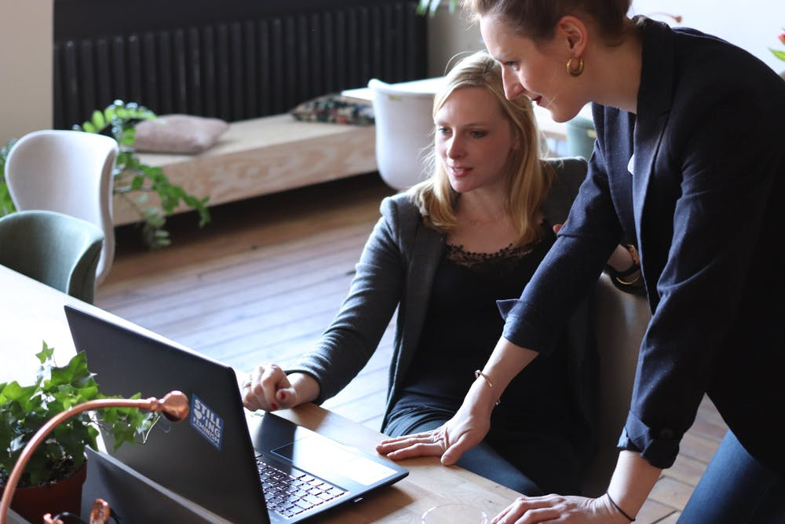
Exclusive jobs curated in an exclusive way
Job opportunities are coming from external clients and exclusively curated by fellow members.
The principle is that no agency is involved in the process, demanding a cut or margin on the future invoices of the retained independent professional.
The job board also contains opportunities to work for a fellow independent professional or with a betoobe workgroup.
betoobe workgroups are also a materialisation of the opportunity for groups of members to work together in project mode to solve complex client problems.

Slide 9

70% of all the direct revenues from the membership subscription and Mindshare session booking fees are given back to members. The more you contribute the more you earn!
Up to 60% of the subscription fees are distributed to members who invite others to join, and to members who actively manage a community of expertise to compensate fairly for the time they spend supporting their peers. Members who recruit, or find a business opportunity for other Independent Professionals are keeping up to 80% of their booking and finders' fees.
The remaining 30% is used to support the running, maintenance and development of the ecosystem.
The only independent professional ecosystem where members are incentivised to help each other

Slide 10
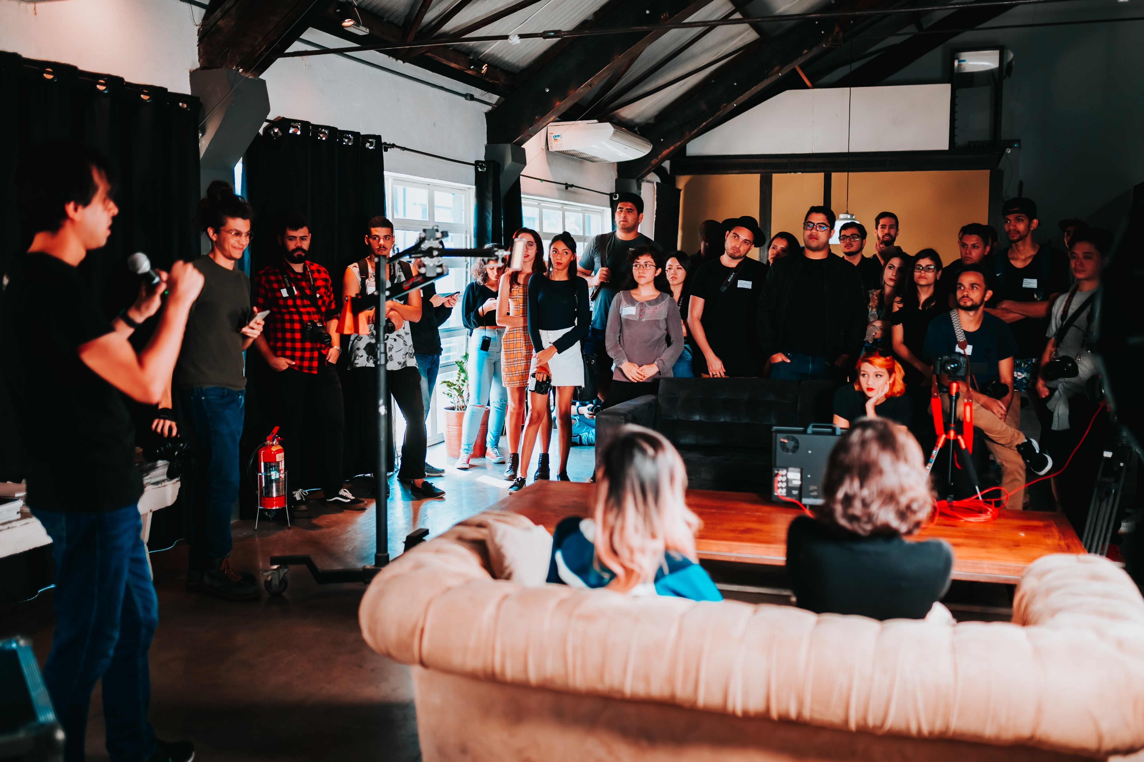
The only
personal development program dedicated to
Independent Professionals
Several times a year, members are invited to book a seat in a 1 to 3 days international event focusing on one aspect of the Independent Professional profile.
The format can be bootcamps, theatrical performances, group coaching sessions, conferences, etc and are facilitated by international trainers and keynote speaker.
Events are usually mixed with networking experiences, especially in the evenings during an event spanning several days.

Slide 11

Special discounts and exclusive deals for members
A series of special offers by external partners, exclusively for the members.
Group purchases or volume discounts are also possibilities to produce value for members.
Potential examples : discount on insurance, subscriptions, computers, parking, etc.
Note : Subscription and events, including the ones organised abroad, are fully deductible as professional expenses.
Benefits and advantages more than compensate the membership fee !

Slide 12

organised ecosystem

Slide 13
Built and owned by members
By Independent Professionals
for Independent Professionals
Personal
Development
Income
Opportunities
Accessible on invitation only
Made to help Independent Professionals grow
Made to help Independent Professionals develop their business
Organised Ecosystem
Committed to generate higher collective value through collaboration
Helping Independent Professionals
to monetize their network & expertise
Online Platform
And betoobe is NOT an advertising media

Slide 14









What you find in other platforms is also available here
interest groups
work groups
To be an organised ecosystem, betoobe brings two exclusive types of groups
team
community
Composed of all the members who have been invited by a given member. New members are automatically added to the group of their referrer.
This type of group is where members will express their support to all their referrals, helping them navigate the platform, connect to the right people, get answers to their questions and more generally increase the value they get from betoobe.
This is the “home” of members, how they define themselves professionally on the market. How they can be meaningfully grouped to maximise the value of what they do together.
When possible, communities are subdivided to allow members to join the subcommunity that best defines what they do and where they do it, to foster in person interactions between neighbours in a community and to take local cultures into account in the animation of these groups

Slide 15








LEARNING
Legendary
Booking mindshares
Reading insights
Getting answers
…
Mythic
CONTRIBUTING
Heroic
Generating activities
Writing insights
Giving answers
…
CARING
Master
Referring members
Supporting referrals
Create relevant events
…
MINDSHARING
Adept
Conducting mindshares
Support attendants
Create relevant events
…
Apprentice
5 Stars
ACTIVATING
Finding opportunities
Creating project teams
Recommending peers
…
Members are recognised and incentivised for conducting activities helping themselves and other Independent Professionals to grow and generate income

Slide 16



Gold
(48 € / month)
Platinum
(96 € / month)
All you need to Thrive
All you need to Generate Income
All ecosystem services
Collaborative platform
Member advantages
Business opportunities
Same as Gold +
Activating (€€)
Caring (€€)
Mindsharing (€€)
Community Management (€€)
Exclusive advantages
LEARNING
CONTRIBUTING
ACTIVATING
CARING
MINDSHARING
Booking Mindshares
Reading insights
Getting answers
…
Generating activities
Writing insights
Giving answers
…
Finding opportunities
Creating project teams
Recommending peers
…
Referring members
Supporting referrals
Create relevant events
…
Conducting Mindshares
Support attendants
Create relevant events
…

Slide 17

income opportunities

Slide 18


+ 3,600 €
Average Expected Monthly Revenue in any of the three
Income Generating Activities
They can be cumulated !
17,000 €
+ 1,800 €
9,000 €
5,500 €
Legendary
3,000 €
Mythic
1,500 €
Heroic
700 €
Master
Adept
300 €
Apprentice
Approximative numbers to achieve the minimum points for badges in any given month
5 Stars
~ 10 bookings
~ 25 bookings
~ 60 bookings
~ 120 bookings
~ 200 bookings
~ 350 bookings
~ 600 bookings
~ 24 downline
~ 60 downline
~ 180 downline
~ 400 downline
~ 900 downline
~ 1800 downline
~ 3000 downline
~ TBD
~ TBD
~ TBD
~ TBD
~ TBD
~ TBD
~ TBD
Badge
Mindsharing
Caring
Activating

Slide 19

CARING
TRACK
CALCULATE
The provided excel sheet is ready to simulate the launch configuration with Gold and Platinum only as well as the introduction of the Silver membership later.

Slide 20
MINDSHARE
TRACK
CALCULATE

Slide 21
PAYING MEMBERS
TEAM #
COMPENSATION
be-TEAM
400
7
2,000 €
900
7
4,000 €
1,800
7
6,000 €
3,000
7
8,000 €
6,000
10
10,000 €
9,000
12
12,000 €
12,000
14
14,000 €
15,000
16
16,000 €
30,000
20
20,000 €

Slide 22
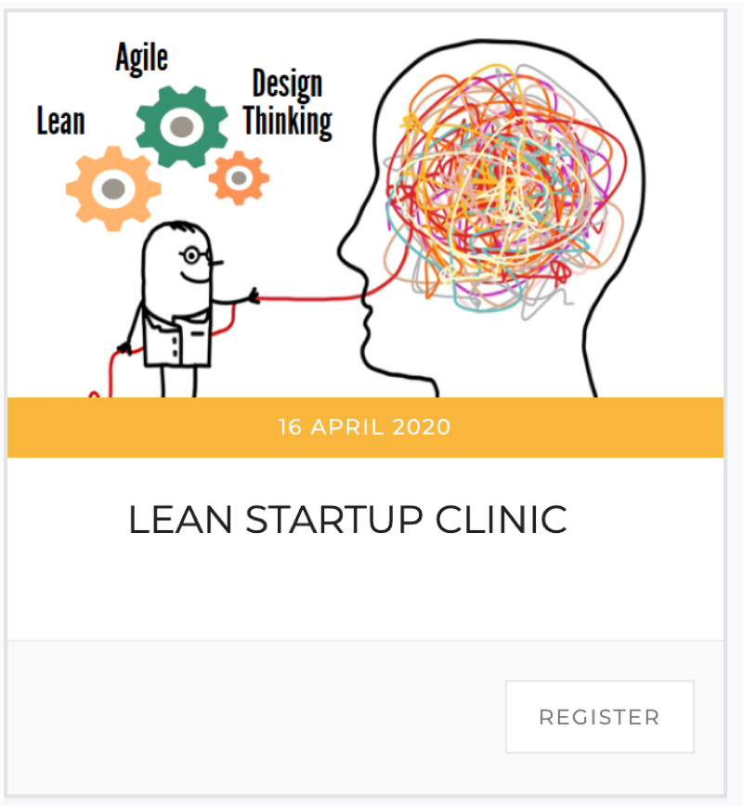
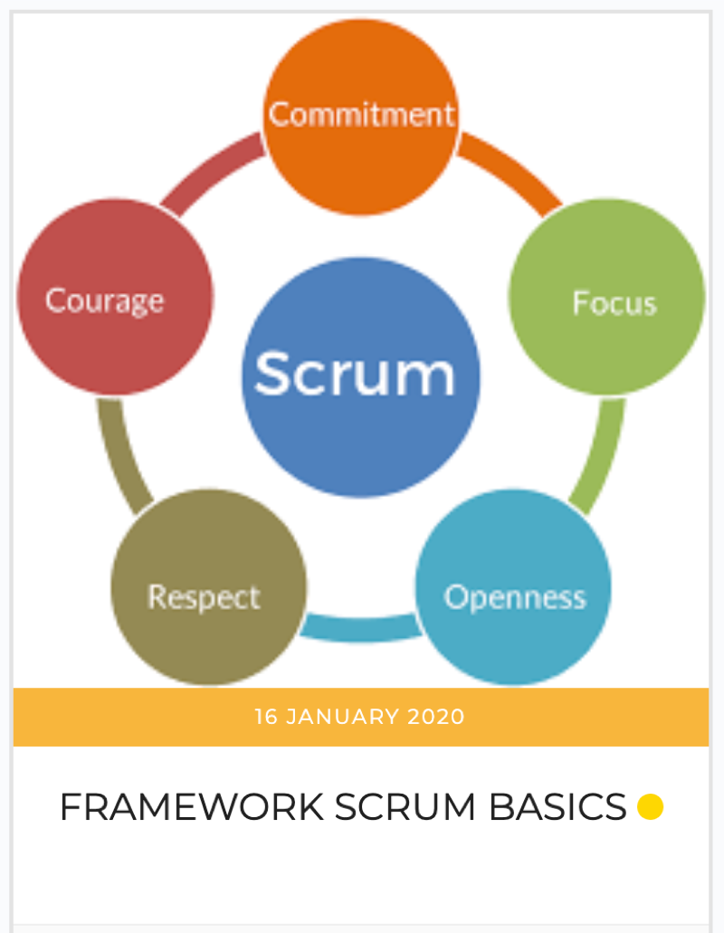
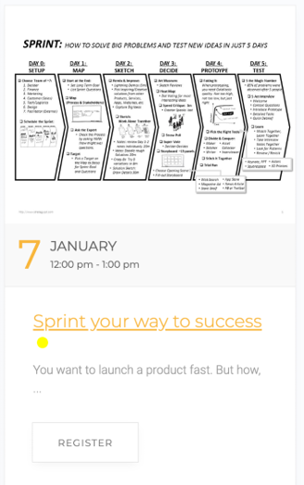
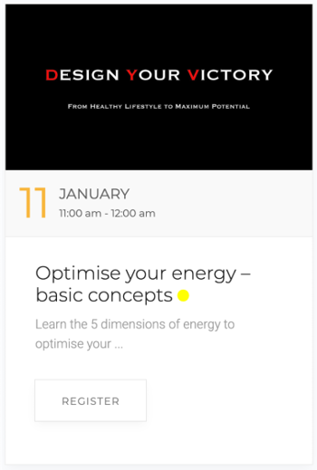
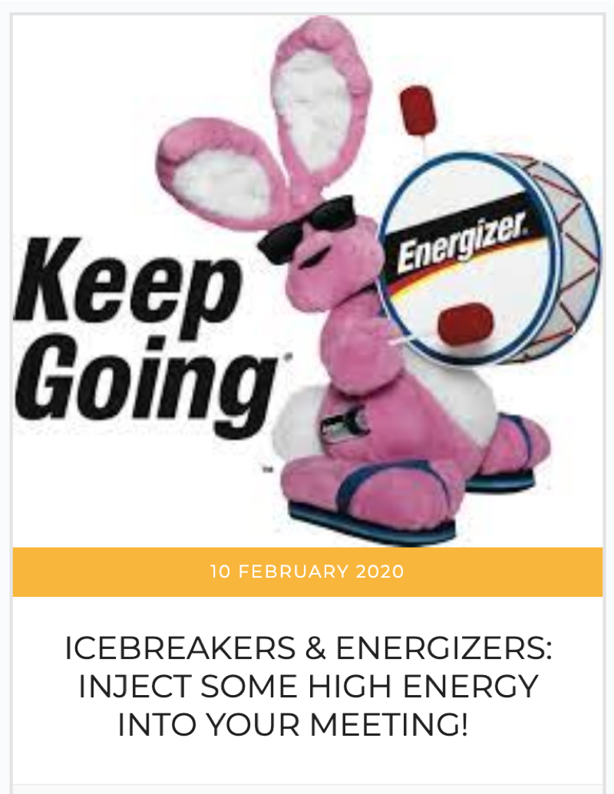
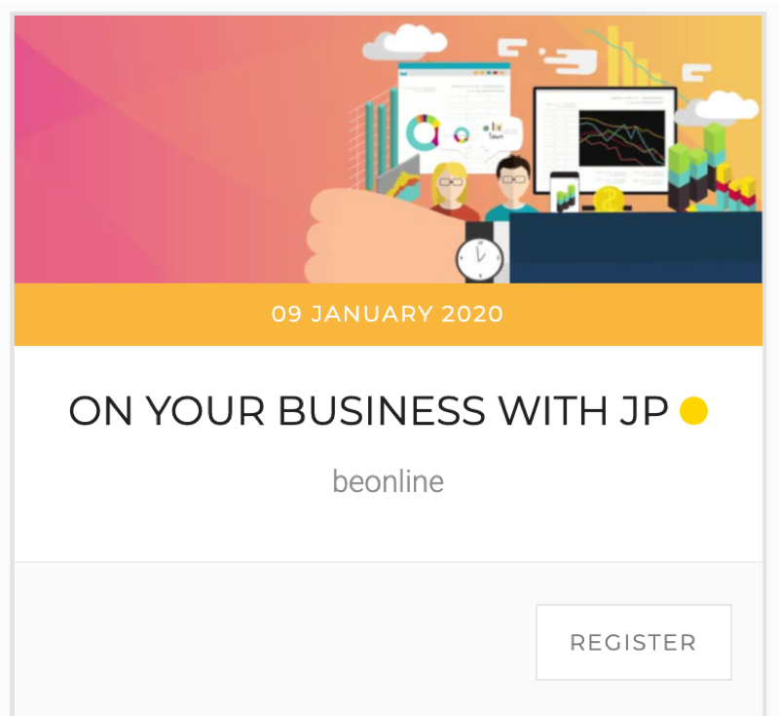
Exclusive Peer-to-Peer Mindshares

Slide 23
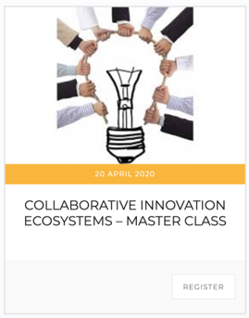
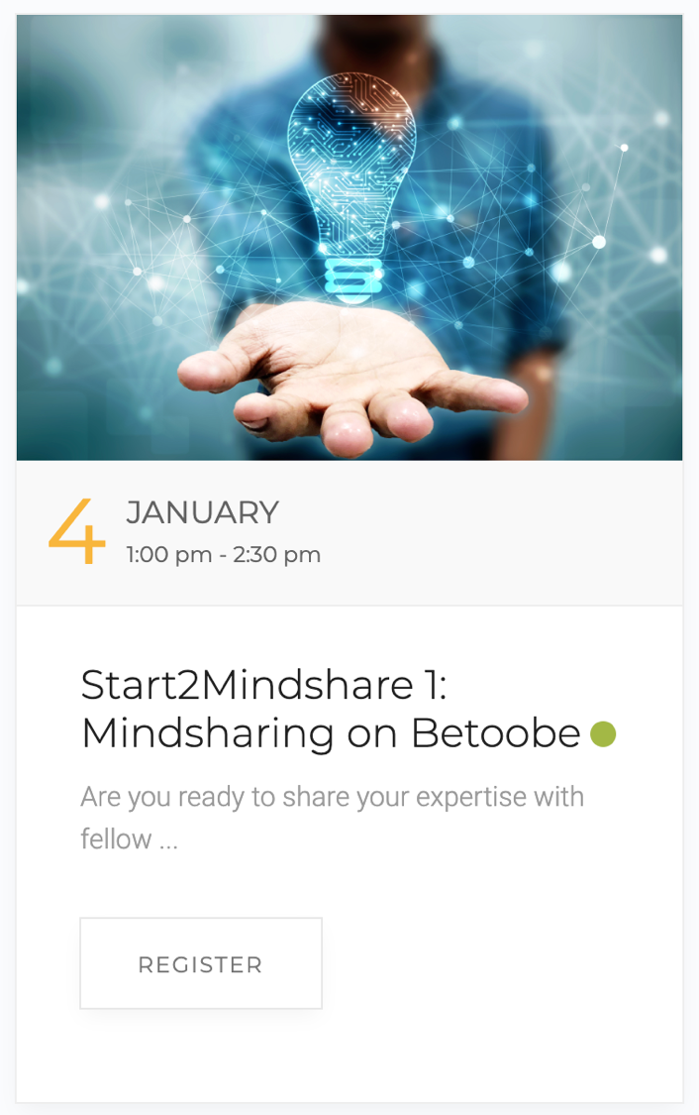
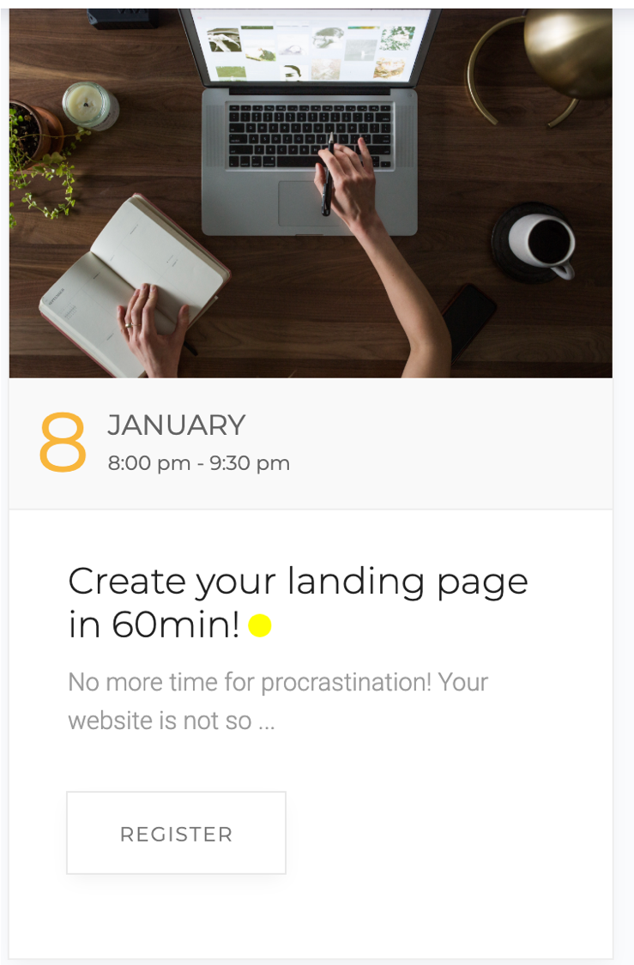


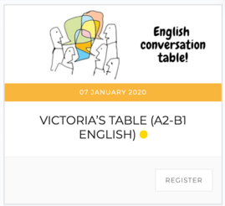
Exclusive Peer-to-Peer Mindshares

Slide 24
In your relationship with others, you care, you empathize, create value and build trust through valuable relationship bonds.
In your relationship with yourself, you see yourself growing, connecting, getting things done and having an impact.
You benefit from a supportive community sharing confidentiality and collaboration as key values.
You are made to be a (Founding) Member.

Slide 25



Independent professionals are creating their new ecosystem. You can for 48€ or 96€/ month*
* with 1-month free trial

